Slide 1
Snap-Meal
Recognizer
Group 29

Slide 2
Team Members
郭原廷
蕭伃君
黃竑翔
Project Manager & Programmer
Researcher & Tester & API
Data Collector
盧冠宇
許媄香
陳翰陞
Programmer
Researcher & Tester & API
Data Collector

Slide 3
Catalog
01
Model Introduction
04
Snap & Detect
YOLOv7
Upload in Spaces🤗
02
Data Preparation
References
05
collect, label, preprocess, convert,
03
Train the model
06
Q&A
Input data, parameter, outcomes

Slide 4
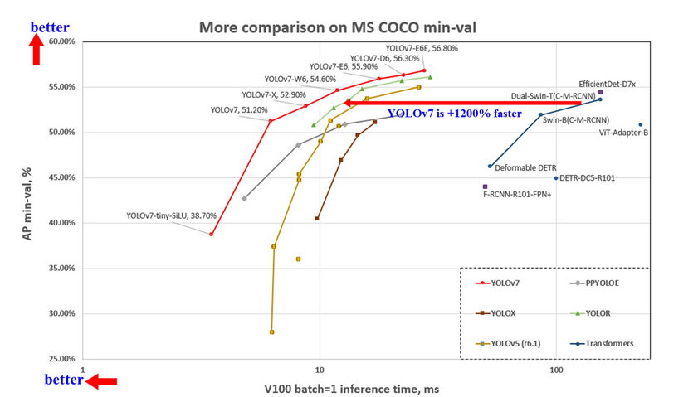
Model Introduction
Compare existing real-time object detectors

Slide 5
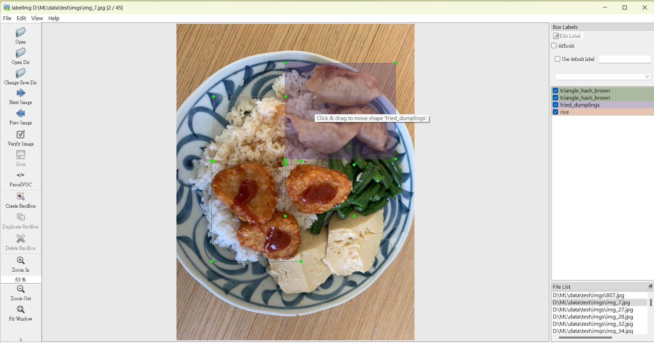
Data Preparation
Collecting Photos
Real photos taken from cafeteria or from github
How we collect and process our data?
Labelling Data
Label each dishes
by “LabelImg”
Data Preprocess
Modify the data to improve performance
Convert Format
Convert into txt files by online sources

Slide 6
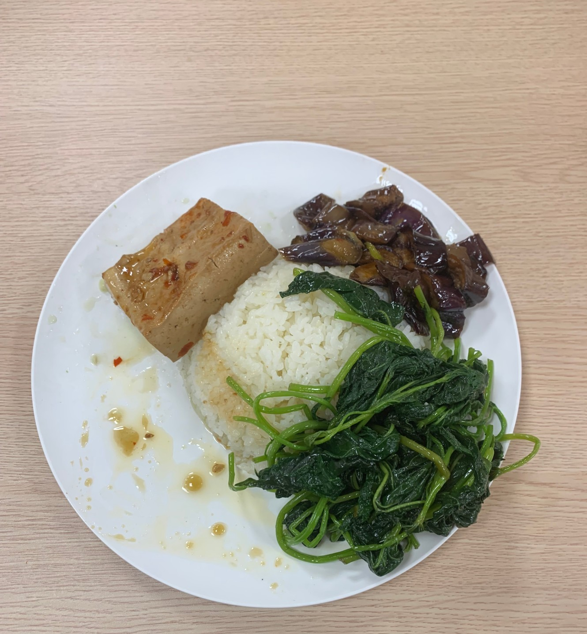
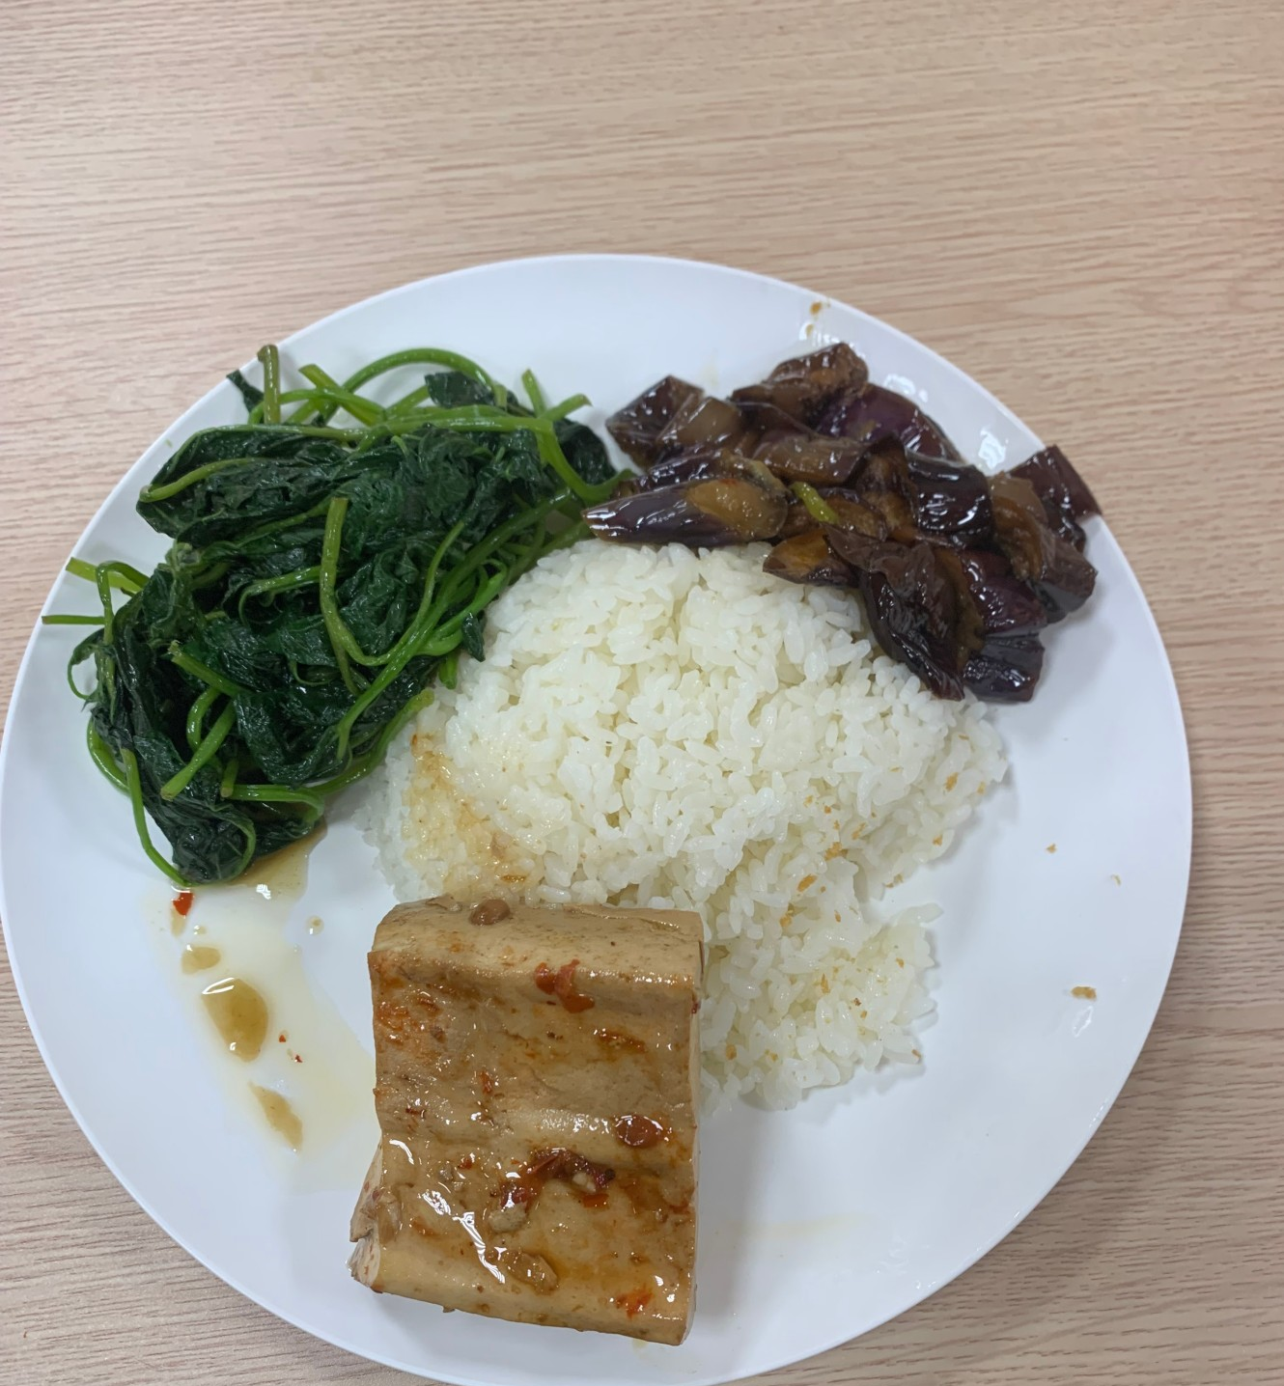
Data Preprocess
01
02
IMPROVE!
Data Augmentation
Data Imbalance Process
Collecting photos taken with different angles
Eliminate rare data (dishes) among dataset

Slide 7
Train the model
YOLOv7 training process
01
02
03
04
Input data
Parameter
Outcomes
Output file

Slide 8
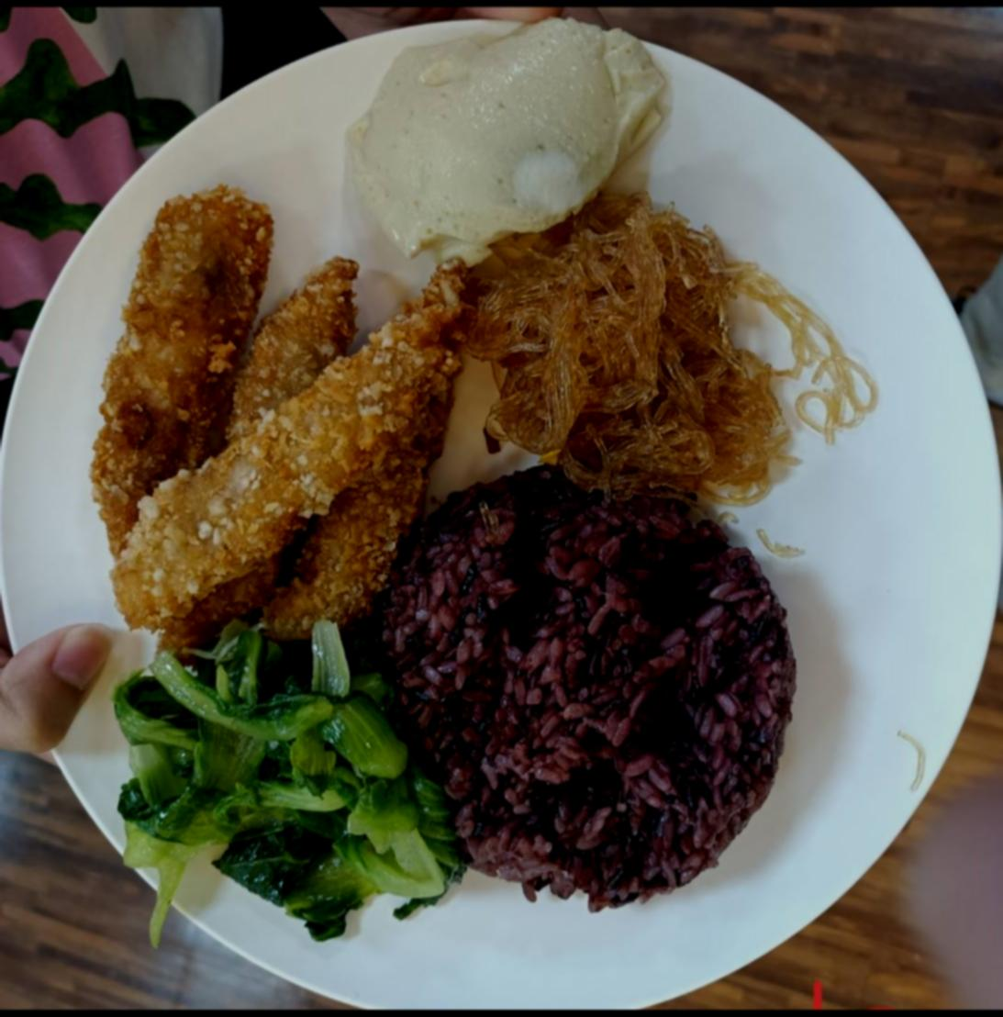
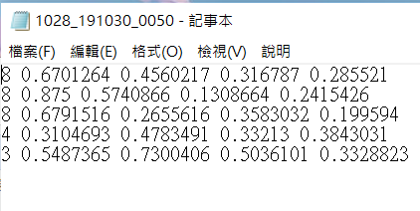
Input data

Slide 9
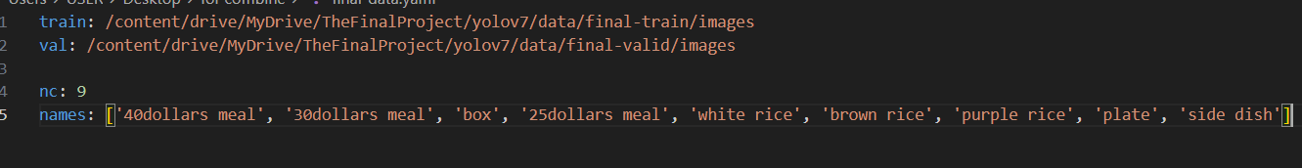
Parameter
batch-size 16
epochs 300
img 640 640
data data/final-data.yaml

Slide 10
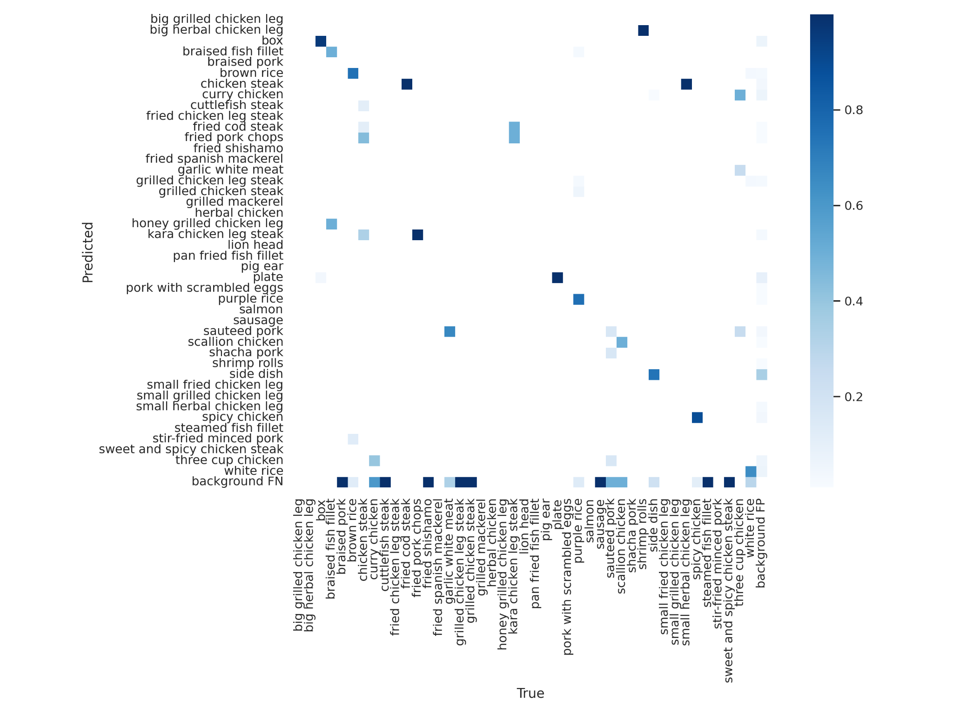
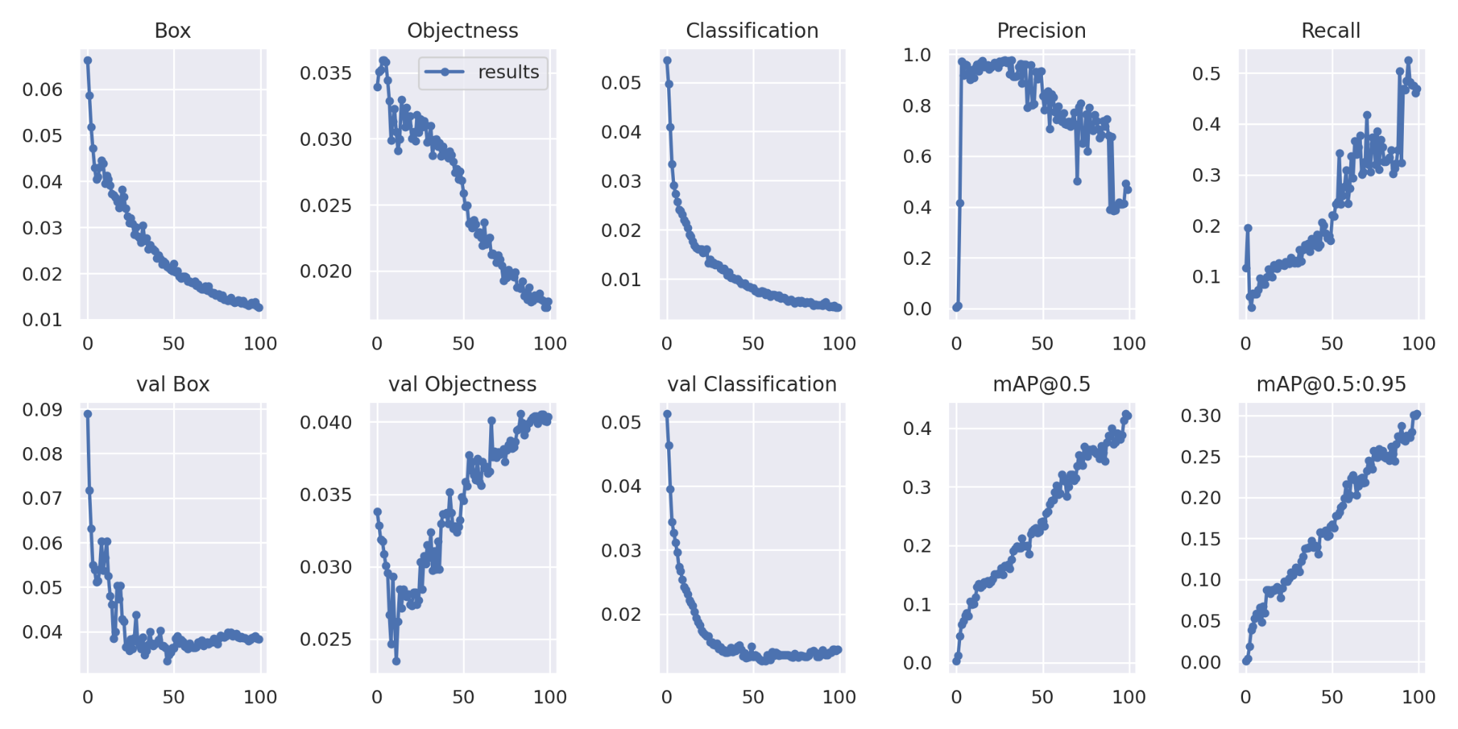
First Outcome
Confusion matrix
All result

Slide 11
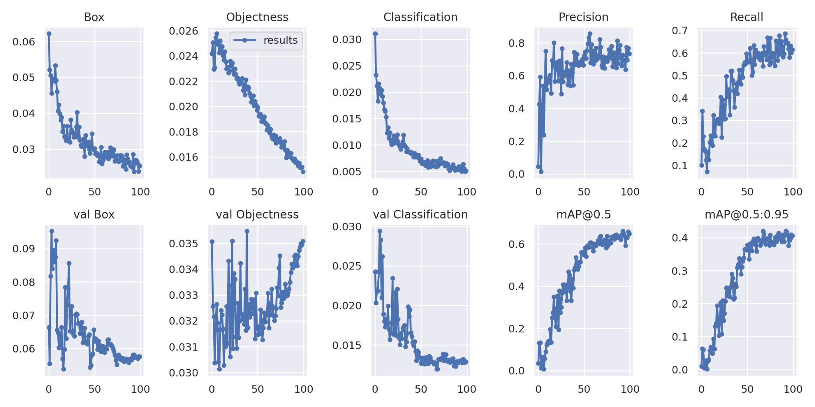
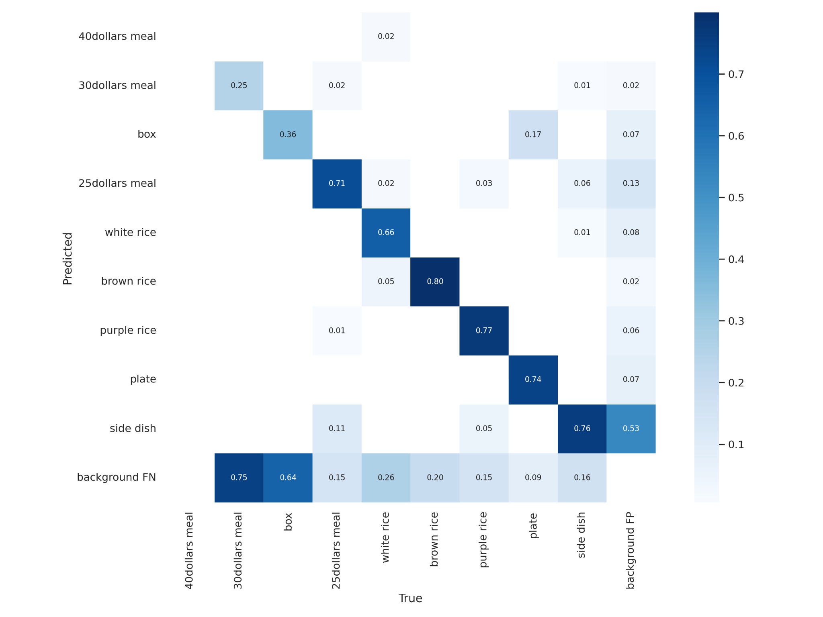
Second Outcome
Confusion matrix
All result

Slide 12
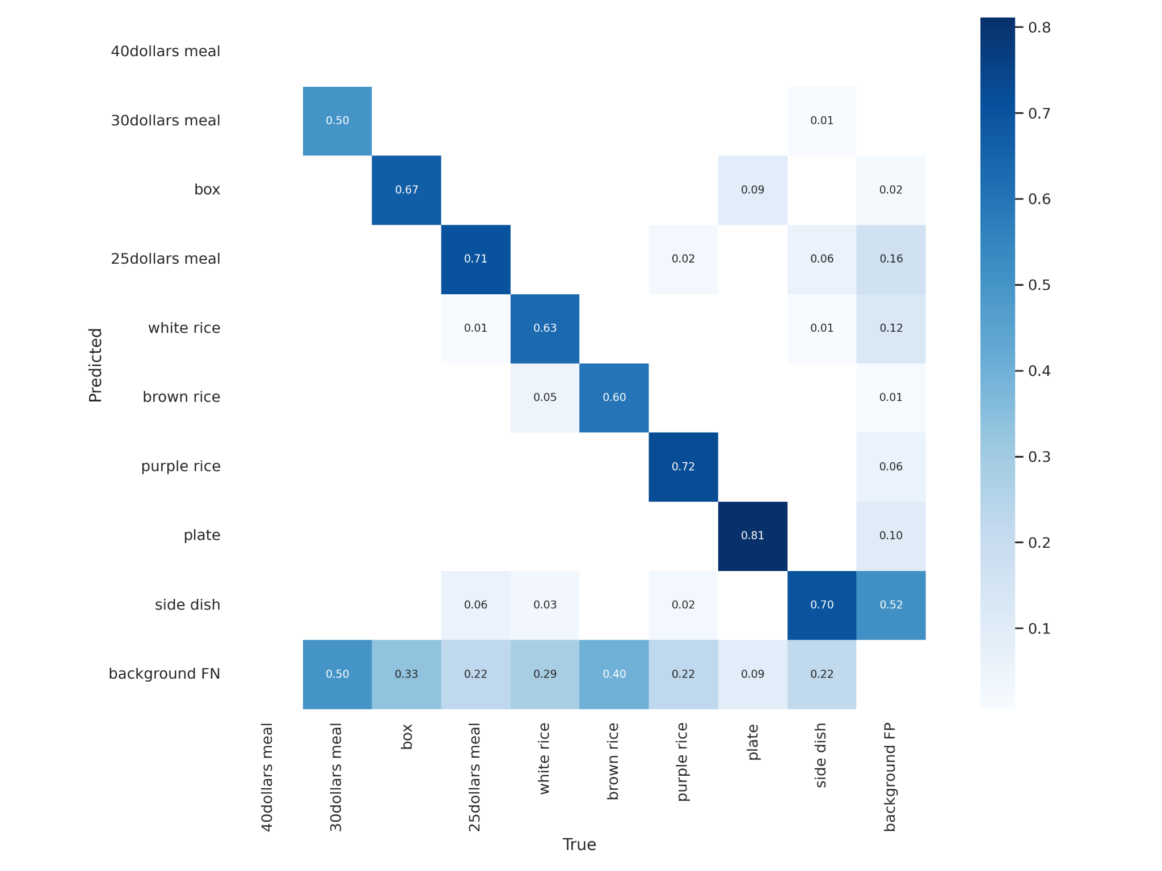
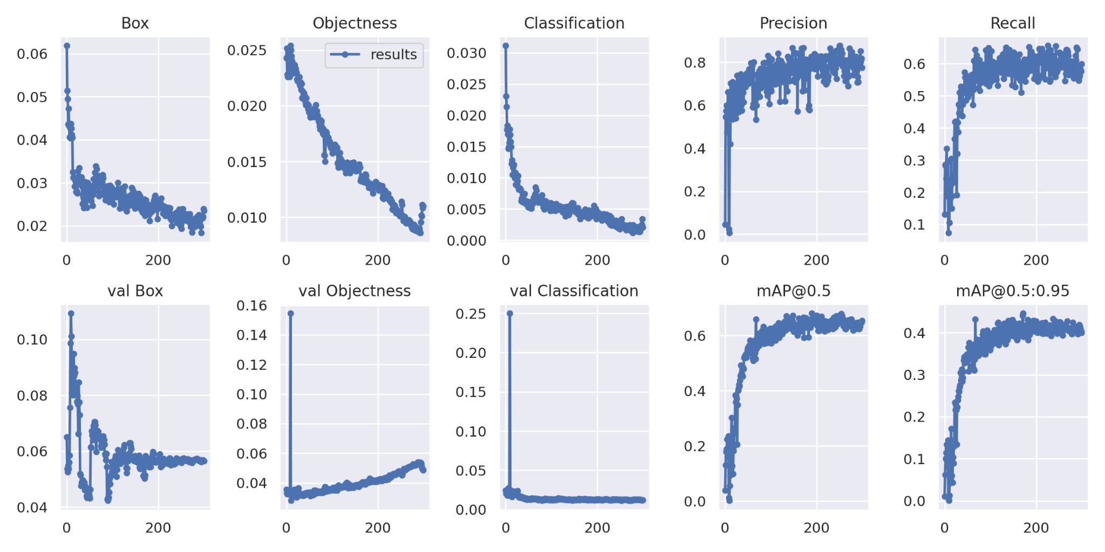
Final Outcome
Confusion matrix
All result

Slide 13



Snap and Detect
Snap 📷
Evaluate💵
Take a picture & upload!
Find out the price in detail!
Click the link
Real-time
Take a picture
Price Revealed
Upload
🔗: https://huggingface.co/spaces/mamechin/AI-Cafeteria-Price-Evaluator

Slide 14
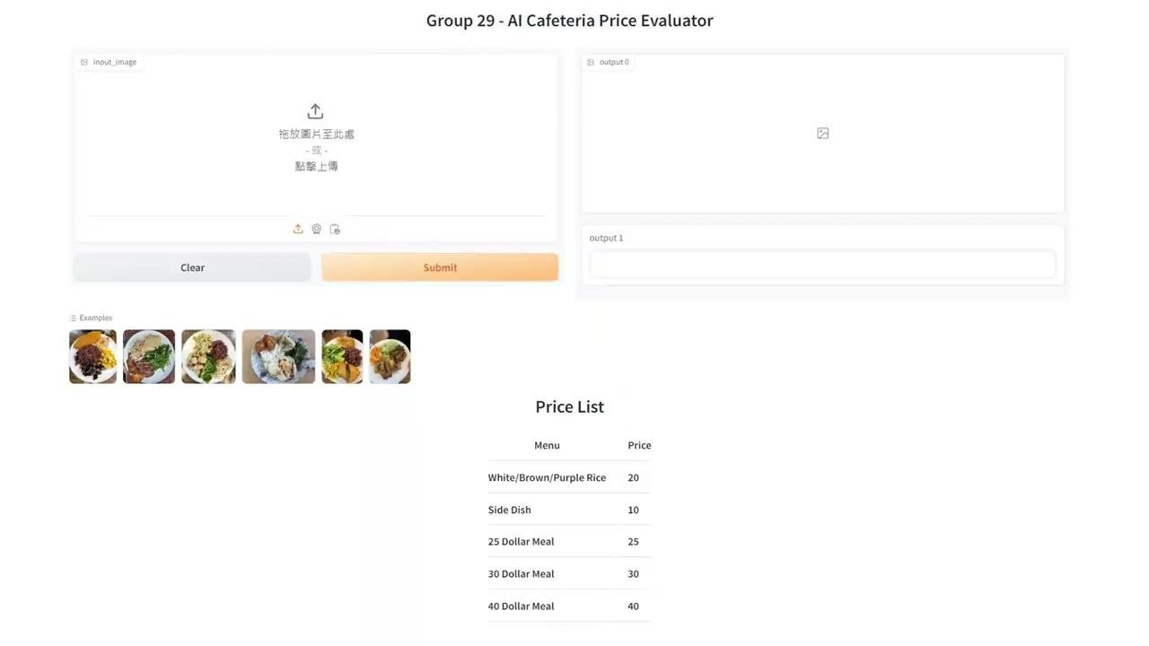
Demo

Slide 15
References
[1] Karndeep Sligh (2021, April 21). Train YOLOv5 on CUSTOM DATASET FAST & EASY - Object Detection | Deep learning | Data Science. Youtube. https://www.youtube.com/watch?v=2nR2e4J4ZaI [2] uncle_II (2022, April 11). yolo图像检测数据集格式转换：xml 与 txt格式相互转换. CSDN. https://blog.csdn.net/uncle_ll/article/details/116197413 [3]YOLOv7 model. https://github.com/WongKinYiu/yolov7 [4]YOLOv7 教學https://docs.oneai.twcc.ai/s/casestudy-yolov7#3-%E8%A8%93%E7%B7%B4-YOLO-%E6%A8%A1%E5%9E%8B [5]【YOLO v7】03-輸出結果至檔案 https://blog.eddie.tw/yolo-v7-print-result-to-file/ [6]YOLOv7 介紹 https://aiacademy.tw/yolov7/ [7] Gradio-YOLOv5-YOLOv7 搭建Web GUI https://blog.csdn.net/WhiffeYF/article/details/132069388 [8] Load YOLOv7 using torch.hub https://colab.research.google.com/drive/1nKoC-_areXmc_20Xn7z6kcqHEKU7SJsX#scrollTo=yyB_MQW1OWhZ

Slide 16
Q&A

